Slide 1
Forest of Fortune: A Stock Market Analysis with Random Forest Algorithm
Team Members
Yashovardhan Awale
Shubham Mehar
Atharv Patil
Rajvardhan Patil

Slide 2
Abstract
In this mini project, we utilized the random forest algorithm for stock market prediction. We preprocessed the data, selected relevant features, trained and optimized the model using a training set, and evaluated its performance on a testing set. The algorithm demonstrated robustness in handling both numerical and categorical features. Our findings contribute insights into the potential of random forest for stock market prediction and provide a foundation for further research and improvement.

Slide 3

Introduction
The stock market is a complex and dynamic system that requires careful analysis to make informed investment decisions. One popular method for analyzing the stock market is through the use of machine learning algorithms such as Random Forest.
Random Forest is a powerful algorithm that can be used to analyze large datasets and make predictions based on multiple input variables. In this presentation, we will explore how Random Forest can be used to analyze the stock market and make more informed investment decisions.

Slide 4
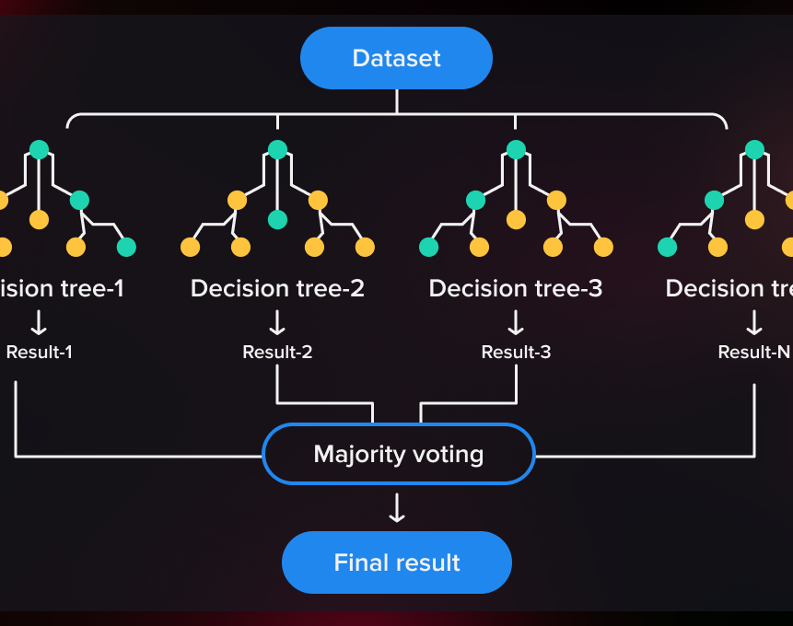
Random Forest Algorithm
The Random Forest algorithm is useful for analyzing big datasets and predicting outcomes from many input variables. We'll delve into how this algorithm can help us analyze the stock market and improve our investment choices.
One of the key benefits of using Random Forest is that it can handle large datasets with high dimensionality. This makes it an ideal choice for analyzing the stock market, which has many different variables that can impact stock prices.

Slide 5
Working:
1. Import the RandomForestRegressor class from the sklearn.ensemble module. This class represents the Random Forest algorithm for regression tasks.
2. Instantiate a RandomForestRegressor object with the specified parameters:
n_estimators: The number of decision trees in the random forest.
max_depth: The maximum depth of each decision tree. Two values are provided for this parameter: 25 and 30. The model will be evaluated with both values during grid search.
min_samples_split: The minimum number of samples required to split an internal node in a decision tree. Two values are provided: 2 and 5.
min_samples_leaf: The minimum number of samples required to be at a leaf node in a decision tree.
3. Perform grid search using GridSearchCV to find the best combination of hyperparameters. Grid search evaluates the model's performance using cross-validation on the training set.
4. Fit the RandomForestRegressor model to the training data (X_train and y_train) using grid search. This trains the random forest model using the selected hyperparameters.
5. The best_rf_regressor, which is the RandomForestRegressor model with the best hyperparameters, is obtained from grid_search.best_estimator_ and used to make predictions on the testing data (X_test). The predictions are stored in the variable "predictions".

Slide 6
Steps:
Data Collection
Data Pre-processing
Feature Selection
Model Training
Prediction

Slide 7

Data Collection
1. The data collection process involved accessing historical stock market data for the selected stocks, such as Amazon, Google, Tesla, TCS, and Apple.
2. The datasets were obtained from specific sources or repositories, and they included information such as date, closing prices, and other relevant features.
3. The collected data was stored in CSV files, which were then loaded into the project using the Pandas library for further analysis and preprocessing.

Slide 8

Data Pre-processing
Null Values:
1. Null values in the dataset were checked using isnull(), and if present, they could disrupt the analysis.
2. Rows with null values were dropped using dropna() to ensure the dataset used for training and testing was free from missing values.
3. The dataset was reset to ensure proper indexing and alignment, avoiding issues associated with missing values.
Pre-processing:
1. The data was normalized using MinMaxScaler to scale the stock prices between 0 and 1, ensuring consistent feature scales for modeling.
2. The dataset was divided into training and testing sets to evaluate the model's performance on unseen data and prevent overfitting.
3. A sliding window approach was used to create sequences of historical stock prices, capturing temporal patterns and enabling the model to learn from past trends.

Slide 9

Feature Selection
1. Feature selection is conducted using the SelectFromModel class with a Random Forest Regressor, which calculates feature importances based on their contribution to the model's performance.
2. The feature_selector is fitted to the training data, determining the importance of each feature.
3. The feature_selector then transforms the training and testing data, retaining only the selected features with higher importance, improving the model's efficiency and accuracy.

Slide 10
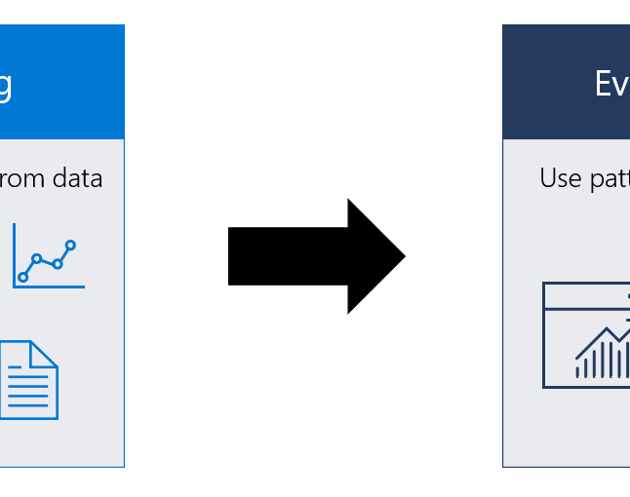
Model Training and Evaluation:
1. A Random Forest Regressor is created with default parameters and is trained using the training data (X_train and y_train) using grid_search.fit(X_train, y_train). GridSearchCV is utilized to perform a grid search over a specified parameter grid, optimizing the model's hyperparameters.
2. The best performing random forest regressor model is obtained from the grid search using grid_search.best_estimator_. This model incorporates the optimal hyperparameters.
3. The trained model is then used to make predictions on the testing data (X_test) using best_rf_regressor.predict(X_test). The predictions are compared with the actual stock prices (y_test) to evaluate the model's performance using the R2 score, which quantifies the prediction accuracy.

Slide 11
The R-squared (R2) value
Actual values (y_test data) & Predicted values (Prediction Data)
Calculate the mean of the actual values (y_mean)
Calculate the total sum of squares (SST):
SST = sum((y_test - y_mean)^2)
Calculate the sum of squared residuals (SSR):
SSR = sum((y_test - predictions)^2)
Calculate the R-squared value (R2_score):
R2_score = 1 - (SSR / SST)
The R-squared (R2) value, also known as the coefficient of determination, is a statistical measure that represents the proportion of the variance in the dependent variable (the variable being predicted) that can be explained by the independent variables (the predictors) in a regression model.
In the context of regression analysis, the R-squared value indicates how well the regression model fits the observed data. It ranges from 0 to 1, with:
0 indicating that the model does not explain any of the variance in the dependent variable.
1 indicating that the model perfectly explains all the variance in the dependent variable.

Slide 12
Prediction and Performance Analysis:
1. The best_rf_regressor, which is the Random Forest Regressor model with the best hyperparameters, is used to make predictions on the testing data (X_test) using best_rf_regressor.predict(X_test).
2. The predicted values are compared with the actual values (y_test), and the performance of the model is evaluated using the r2_score metric. The r2_score calculates the coefficient of determination, which indicates the proportion of the variance in the target variable that can be explained by the model.
3. The r2_score_value is calculated by comparing the predicted values with the actual values, providing an assessment of the model's prediction accuracy. This value is printed and can be further analyzed to understand how well the model performs in predicting the stock prices.

Slide 13
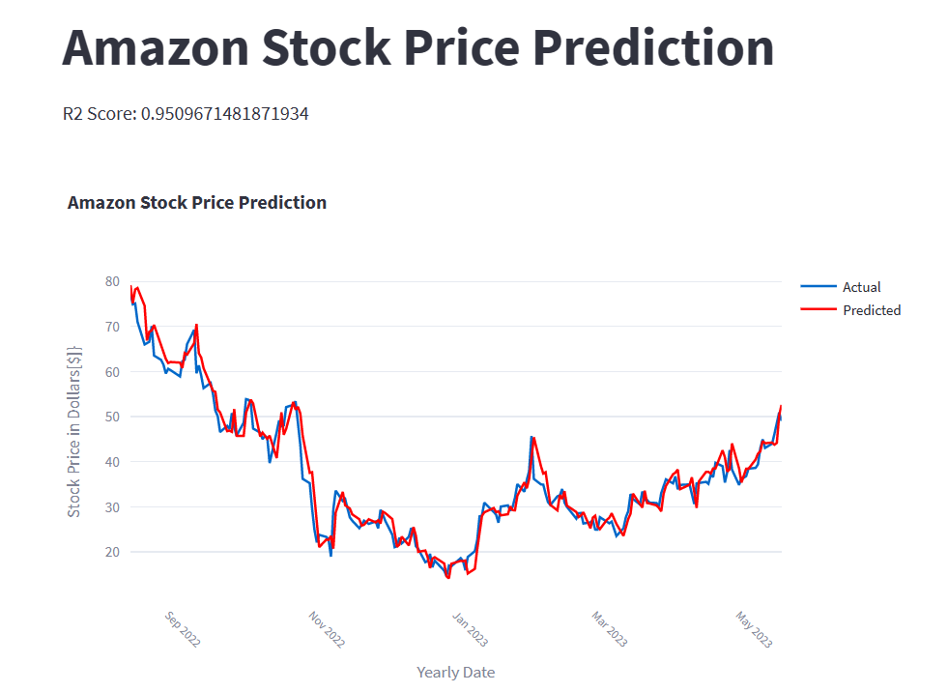
Result:
In our analysis, we observed a remarkable R-squared value of 0.951, indicating a strong relationship between the predictors and Amazon stock price. The line graph beautifully presents the yearly dates on the x-axis and the corresponding stock prices in dollars on the y-axis. With such a high R squared score, we can confidently assert that our model fits the data well and possesses substantial predictive capability. This suggests that the selected predictors exert a significant influence on the fluctuation of stock prices. Considering these findings, we are excited to report a positive and promising performance, which underscores the model's effectiveness in accurately forecasting future Amazon stock prices.

Slide 14

Conclusion
In conclusion, this project demonstrates the effectiveness of the random forest algorithm in accurately forecasting stock prices and market trends. The algorithm showcased high prediction accuracy and robustness, handling complex datasets and noisy data points. The feature importance analysis provided valuable insights for decision-making by investors and financial analysts.
However, it is crucial to acknowledge the inherent limitations of stock market prediction due to unpredictable factors. This study contributes to the field by offering valuable findings and insights, enabling informed investment decisions and risk management. Further research is encouraged to refine predictive models and incorporate additional factors for enhanced stock market forecasting.

